Slide 1
Windows User Interface
ITSC205
Operating Systems Internals

Slide 2
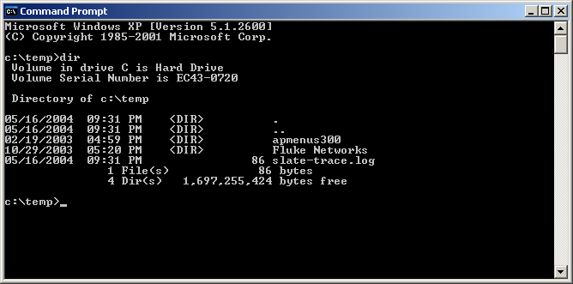
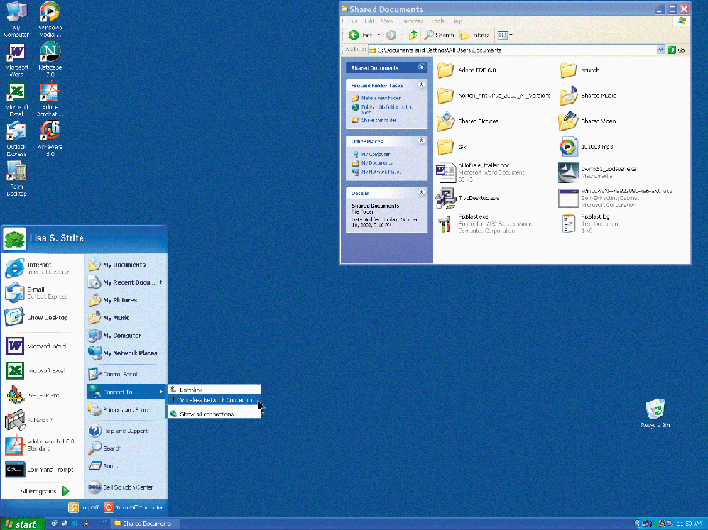
User’s Interface
OS provides a user interface
Command-Line
GUI
Notes:
“Microsoft product screen shot(s) reprinted with permission from Microsoft Corporation.”

Slide 3
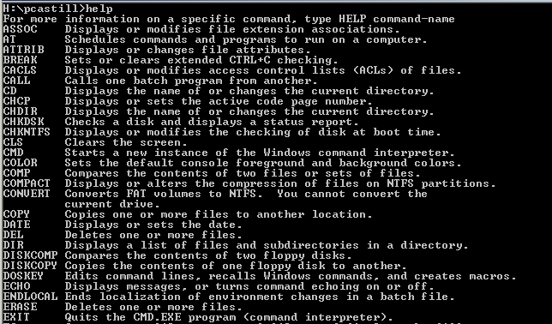
Command Line –cmd command
Notes:
“Microsoft product screen shot(s) reprinted with permission from Microsoft Corporation.”

Slide 4
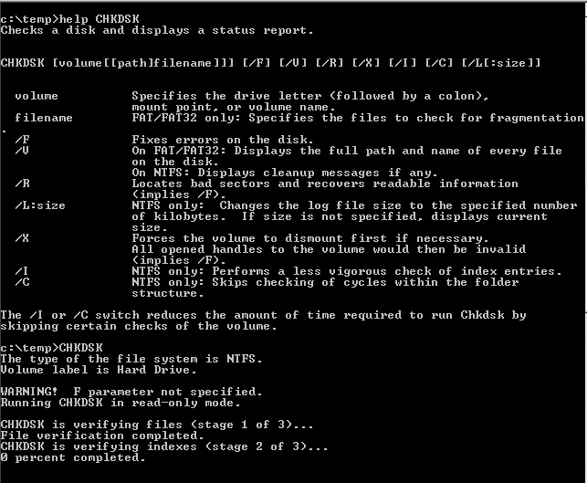
Chkdsk Command
Notes:
“Microsoft product screen shot(s) reprinted with permission from Microsoft Corporation.”

Slide 5
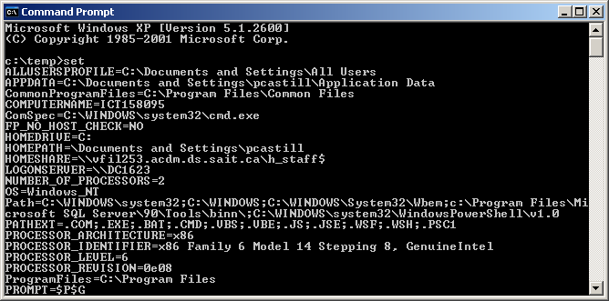
Set command
Notes:
“Microsoft product screen shot(s) reprinted with permission from Microsoft Corporation.”

Slide 6
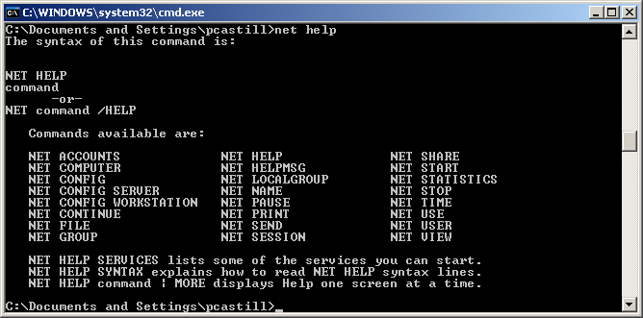
Net command
net use Z: \\computer-name\share-name
Notes:
“Microsoft product screen shot(s) reprinted with permission from Microsoft Corporation.”

Slide 7
Microsoft Windows Management Instrumentation (WMI)
WMI is the core management-enabling technology for Windows
Built into Windows 2000, Windows XP, Windows 7 and Windows Server 2008
Originally released in 1998 as an add-on with Windows NT 4.0 Service Pack 4
Almost all Windows resources can be accessed, configured, managed, and monitored via WMI

Slide 8
WMI Functions
System management
WMI helps to retrieve performance data, manage event logs, file systems, printers, processes, registry settings, scheduler, security, services, shares, and numerous other operating system components and configuration settings
Network management
WMI-based scripts can manage network services such as DNS, DHCP, and SNMP-enabled devices
Internet Information Server, Exchange Server, and SQL Server

Slide 9
WMI- Architecture
The middle layer is the WMI infrastructure
Allows for definition of and accessed to configuration and management data
WMI consists of three primary components:
the CIM Object Manager (CIMOM),
the Common Information Model (CIM) repository,
WMI providers
WMI scripting library is a fourth, small component
A WMI managed resource communicates with WMI through a provider
Notes:
WMI information broker
All WMI requests and data flow through the CIMOM
Implemented inside Windows Management Instrumentation service, winmgmt.exe
CIMOM provides core services:
Provider registration
Request routing
Remote access
Security
Query processing - WMI Query Language (WQL)
Event processing

Slide 10
Exploring the CIM
WMI Command-line
Released as part of Windows XP Professional and Server 2003, the WMI Command-line tool (wmic.exe) provides a command line interface to the WMI infrastructure
You can use wmic.exe to perform common WMI tasks from the command line, including browsing the CIM and examining CIM class definitions

Slide 11
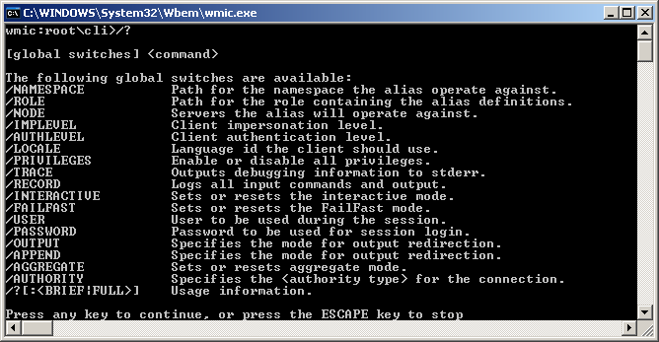
WMIC
Notes:
“Microsoft product screen shot(s) reprinted with permission from Microsoft Corporation.”

Slide 12
Scripting Introduction
A script is a sequence of instructions
Because scripts are plain-text source and not compiled, they are easy to change and to share
Scripting support requires
An engine that reads the scripting language and interprets it
Integration via the scripting engine to interactive functionality

Slide 13
Windows Power Shell
Windows Power Shell is a command-line shell and scripting environment that brings the power of the .NET Framework to command-line users and script writers
Windows PowerShell runs on Windows 7, Windows 10 and Windows Server
Examples:
http://www.microsoft.com/technet/scriptcenter/scripts/msh/default.mspx?mfr=true

Slide 14
Windows PowerShell Scripts
strComputer = "."
Set objWMIService = GetObject("winmgmts:" & _
"{impersonationLevel=Impersonate}!\\" & strComputer & "\root\cimv2")
Set colItems = objWMIService.ExecQuery("Select * from Win32_Process")
For Each objItem in colItems
Wscript.Echo objItem.Name
Next

Slide 15
References
Windows Power Shell
https://docs.microsoft.com/en-us/powershell/scripting/samples/sample-scripts-for-administration?view=powershell-6
WMIC
https://docs.microsoft.com/en-us/windows/desktop/wmisdk/wmic

Slide 16
Copyright Notice © 2000-2005 David A. Solomon and Mark Russinovich
These materials (WMI) are part of the Windows Operating System Internals Curriculum Development Kit, developed by David A. Solomon and Mark E. Russinovich with Andreas Polze
Microsoft has licensed these materials from David Solomon Expert Seminars, Inc. for distribution to academic organizations solely for use in academic environments (and not for commercial use)

